Slide 1

Instagram User Analytics
Jayesh Patil

Slide 2



Introduction
This is a project about Instagram User analysis in which we will be helping Instagram employees to derive business insights for marketing, product & development by providing the data to them using SQL(Structured Query language), by this thing we can get all answers that the employee asked us to upgrade the Instagram services.

Slide 3

Agenda
Marketing: The marketing team wants to launch some campaigns and needs your help with the following.
Rewarding Most Loyal Users:- Find the 5 oldest users of Instagram from the database provided.
Remind Inactive Users to Start Posting:- Find the users who have never posted a single photo on Instagram.
Declaring Contest Winner:- Identify the winner of the contest and provide their details to the team.
Hashtag Researching:- Identify and suggest the platform's top 5 most commonly used hashtags.
Launch AD Campaign:- What day of the week do most users register on? Provide insights on when to schedule an ad campaign.
Investor Metrics: Our investors want to know if Instagram is performing well and is not becoming redundant like Facebook, they want to assess the app on the following grounds.
User Engagement: Are users still as active and post on Instagram or they are making fewer posts Your Task: Provide how many times does average user posts on Instagram. Also, provide the total number of photos on Instagram/the total number of users.
Bots & Fake Accounts: The investors want to know if the platform is crowded with fake and dummy accounts Your Task: Provide data on users (bots) who have liked every single photo on the site (since any normal user would not be able to do this)

Slide 4
Approach
Firstly, I have gone through the data and then analyze the data which sheet has which type of data, afterward I try to join all the sheets then after that I approach the question in My SQL then extract the insightful data from the raw data and answer the question as asked.
Techstack: Ms SQL, PowerPoint

Slide 5
Marketing
The marketing team wants to launch some campaigns and needs your help with the following.

Slide 6
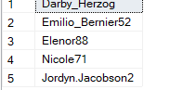
Rewarding Most Loyal Users:- Find the 5 oldest users of Instagram from the database provided.
select top 5 username from users
order by created_at asc;

Slide 7
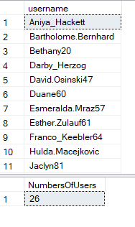
Remind Inactive Users to Start Posting:- Find the users who have never posted a single photo on Instagram.
select u.username
from users u
LEFT JOIN photos p
ON u.id = p.user_id
WHERE p.user_id is null
order by u.username;
select count(u.username) NumbersOfUsers
from users u
LEFT JOIN photos p
ON u.id = p.user_id
WHERE p.user_id is null;

Slide 8
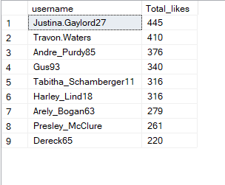

Declaring Contest Winner:- Identify the winner of the contest and provide their details to the team.
Select u.username, count(*) as Total_likes
from likes l
join photos p
on l.user_id=p.user_id
join users u
on u.id = l.user_id
group by u.username
order by Total_likes desc;
Winner

Slide 9
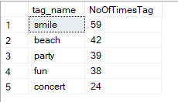
Hashtag Researching:- Identify and suggest the platform's top 5 most commonly used hashtags.
Select top 5 t.tag_name, count(pt.tag_id) as NoOfTimesTag
from photo_tags pt
join tags t
on pt.tag_id = t.id
group by t.tag_name
order by NoOfTimesTag desc;

Slide 10

Launch AD Campaign:- What day of the week do most users register on? Provide insights on when to schedule an ad campaign.
select Day, Total_registered from (
SELECT DATENAME(weekday, created_at) AS Day, COUNT(*) AS Total_registered,
dense_rank() over(order by COUNT(*) desc) rnk
FROM users
GROUP BY DATENAME(weekday, created_at) ) as a
where rnk=1;

Slide 11
Investor Metrics
Our investors want to know if Instagram is performing well and is not becoming redundant like Facebook, they want to assess the app on the following grounds

Slide 12
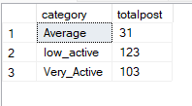
User Engagement: Your Task: Provide how many times does average user posts on Instagram.
select category, sum(NoPost) as totalpost from (
select p.user_id, count(*) as NoPost,
CASE
WHEN count(*)<5 then 'low_active'
when count(*)>5 and count(*)<=9 then 'Average'
else 'Very_Active'
end as Category
from photos p
join users u
on p.user_id=u.id
group by p.user_id) as a
group by Category;

Slide 13

with cte as ( SELECT U.id AS userid, COUNT(P.id) AS NoPhotoId FROM users U LEFT JOIN photos P on U.id = P.user_id GROUP BY U.id ) SELECT sum(NoPhotoId) AS Total_photos,COUNT(userid) AS Total_Users from cte;
provide the total number of photos on Instagram/the total number of users.

Slide 14
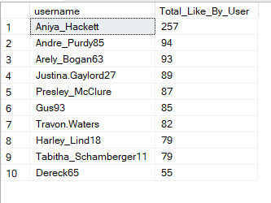
Bots & Fake Accounts: The investors want to know if the platform is crowded with fake and dummy accounts Your Task: Provide data on users (bots) who have liked every single photo on the site (since any normal user would not be able to do this)
Select U.username,
Count(*) as Total_Like_By_User
From users U
join likes L
on U.id = L.user_id
Group by U.username
Order by Total_Like_By_User Desc;

Slide 15
Result
As I learned from this project How to import the word data to my SQL before that I have worked with CSV files so it is difficult to recognize how to import it after that I copy the query and then paste it to MySQL and it worked and this project is beyond the level how to approach the question.

Slide 16
Thank you
Jayesh Patil

